Slide 1


Multi-Year Covid Learning Accelerated Recovery Plan
Board of Trustees Public Hearing, June 14th, 2021

Slide 2

Multi-Year Covid Accelerated Recovery Plan
Taylor ISD strives to inspire, equip, and empower every student to achieve their unique potential. We intentionally empower the whole child based on the following beliefs:
EVERY student has unique potential and shall engage in opportunities to grow in a safe environment through multiple approaches to learning.
Families are partners who will be informed and supported in the educational process to help students discover their unique potential.
Empowered faculty and staff utilize their respected skills to serve as student advocates for the whole child.
The COVID-19 pandemic has greatly impacted our students academically, socially and emotionally. Our data indicates that our students have suffered academic learning loss and as well as the initiative to engage in learning. We believe without significant and sustained interventions, the negative impact on both students and staff will have lasting effects. We must be prepared to provide additional support in the areas of personnel, technology, learning tools, professional development and additional support in operational costs. Through the American Rescue Plan for Elementary and Secondary Schools, Taylor ISD’s anticipated funding is $4,464,477.

Slide 3
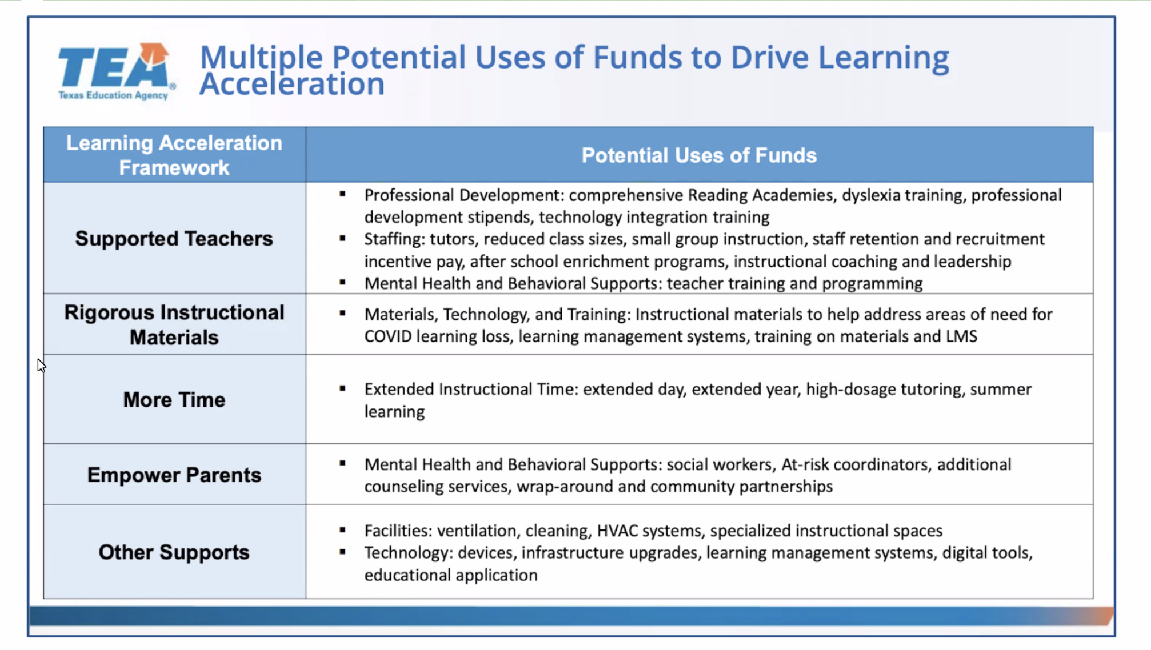
Guiding Principles for ESSER III

Slide 4
Planning for the Use of Funds
Stakeholder Meetings
Community Awareness and Opportunities for Staff Input
Public Hearing on June 14th, 2021
Coordinating and Aligning the Use of All Federal Funds.
Establish and Post Multi-Year Covid Accelerated Learning Recovery Plan
Establish and Post a Return to In-Person Instruction and Continuity Plan
Create Process to review plan every 6 months for the effectiveness of its implementation.

Slide 5
Coordination of All Federal Funds
2021-2022 - ESSA
  Title I - $609,979
  Title IPC (Migrant) - $12,075
  Title II - $121,511
  Title III - $44,467
  Title IV - $44,918
ESSER I - March 13, 2020 - September 30, 2022*
  $493,249
ESSER II - March 13, 2020 - September 30, 2023*
  $2,068,896
ESSER III - March 13, 2020 - September 30, 2024*
  $4,646,447
*Amounts may be reduced due to ADA Hold Harmless adjustments

Slide 6
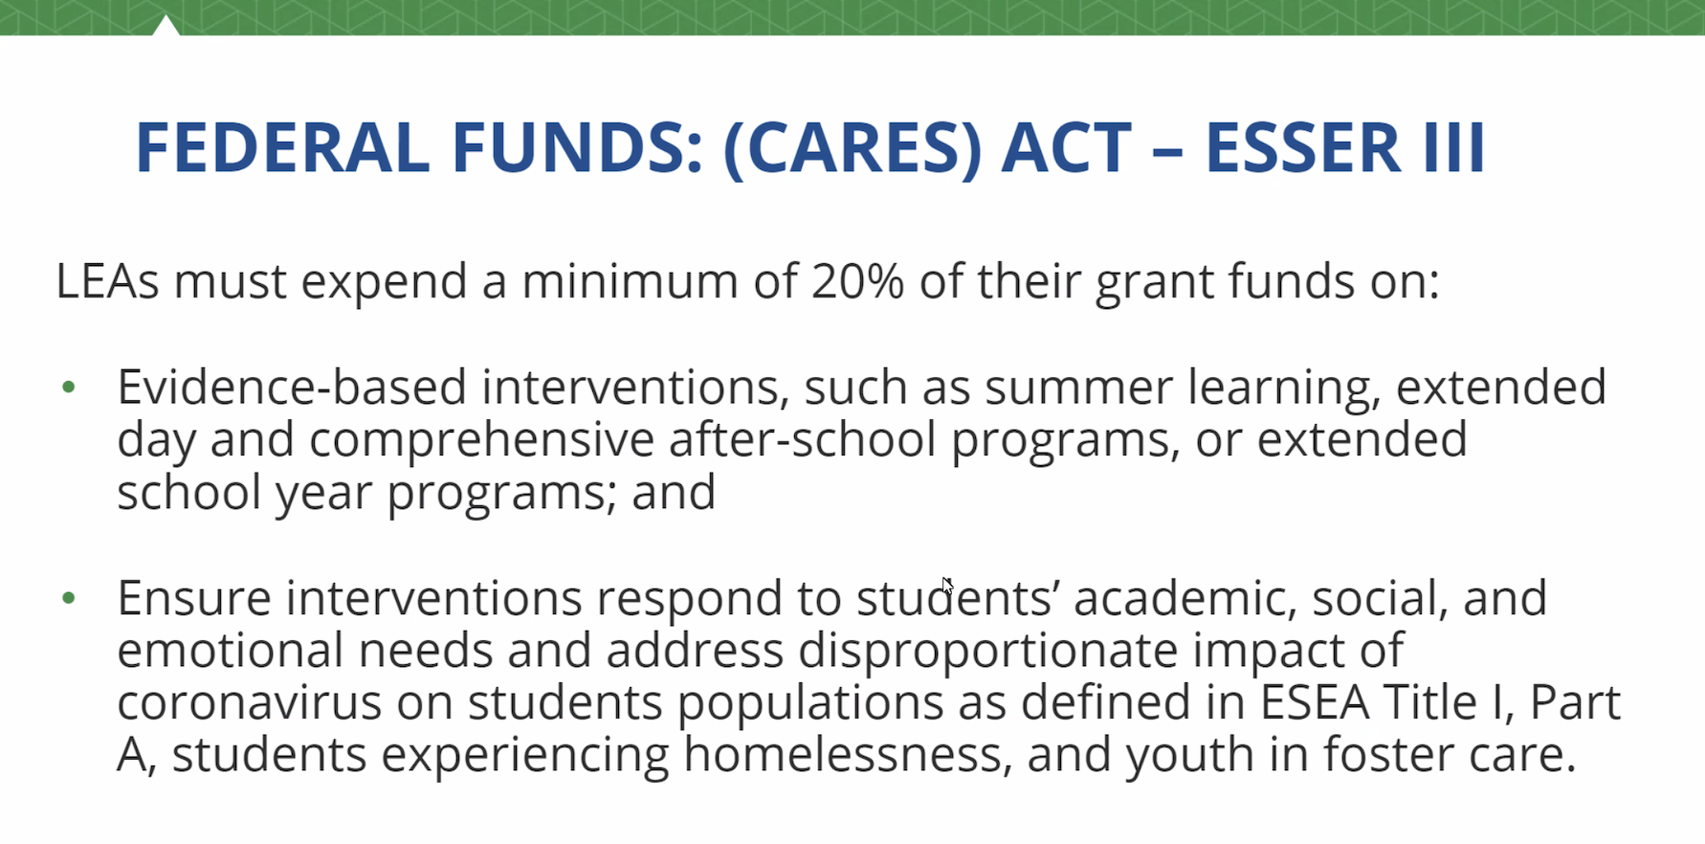
ESSER Funding Restrictions

Slide 7
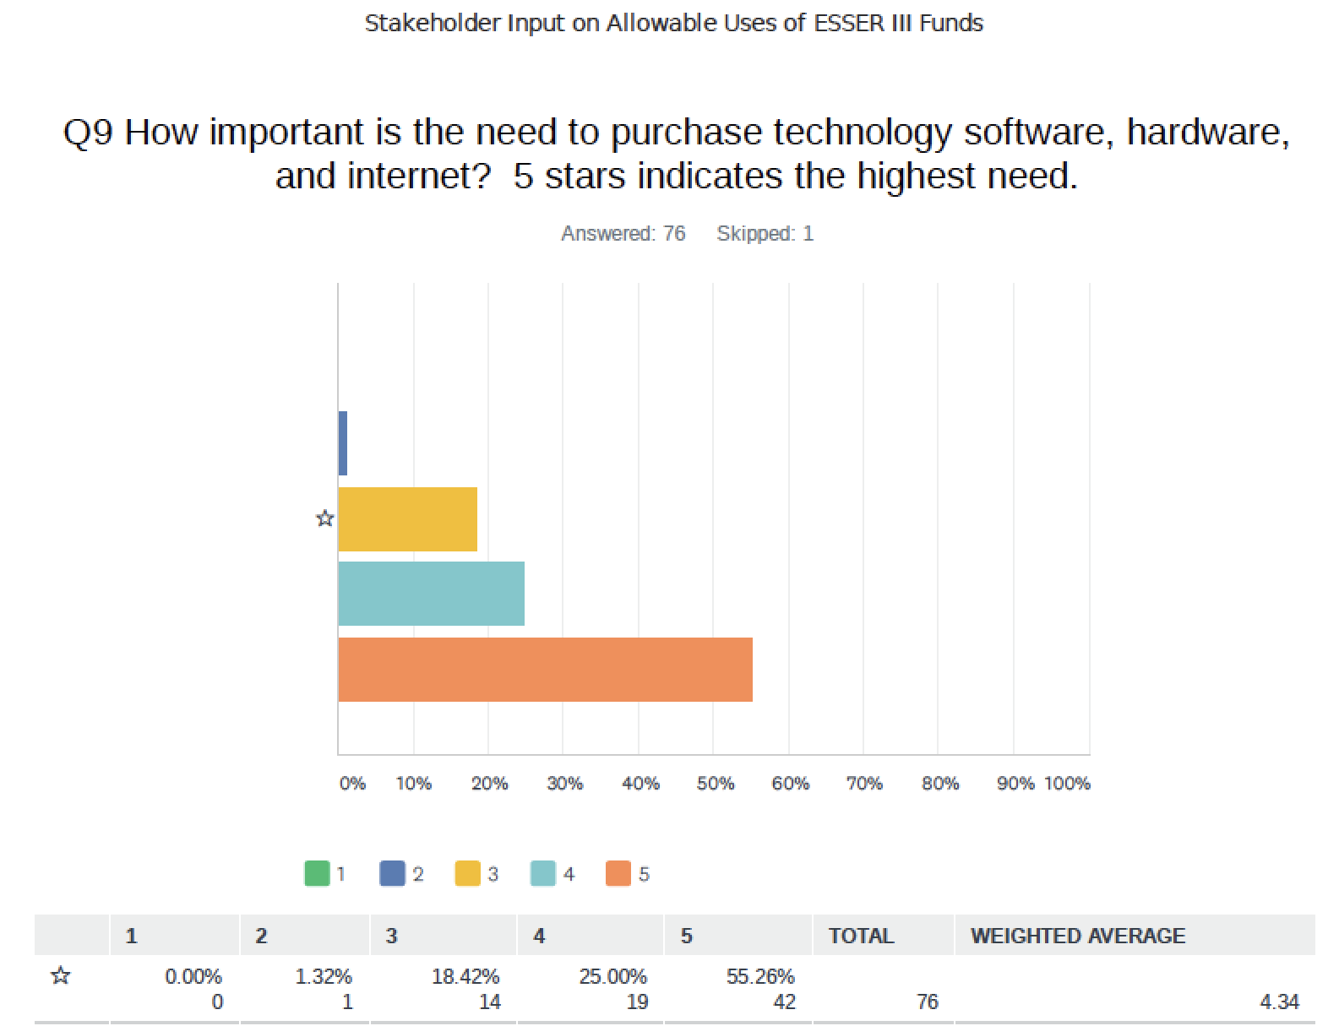
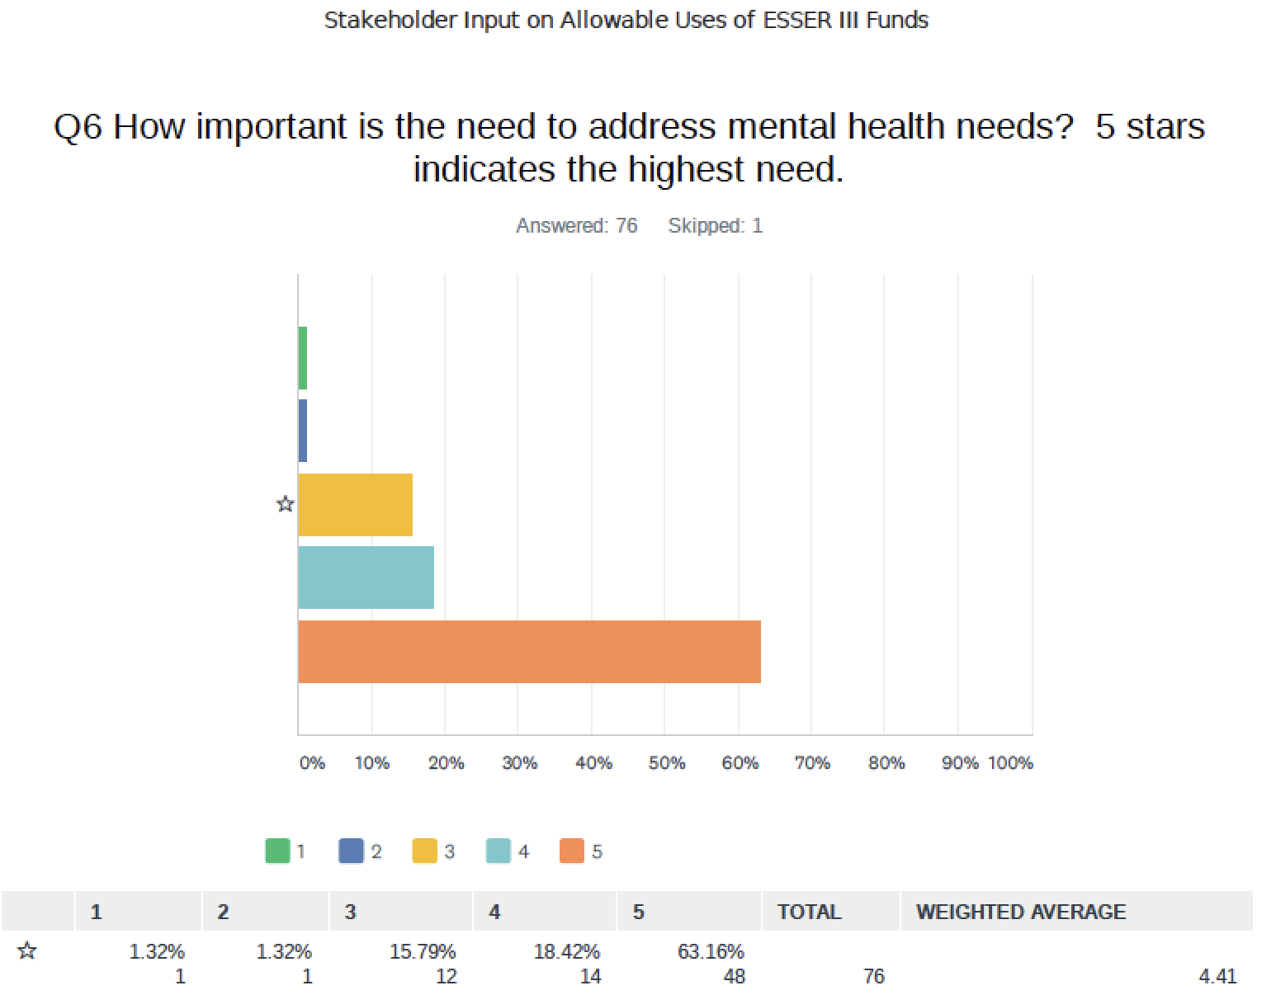
Results of the Community Survey

Slide 8
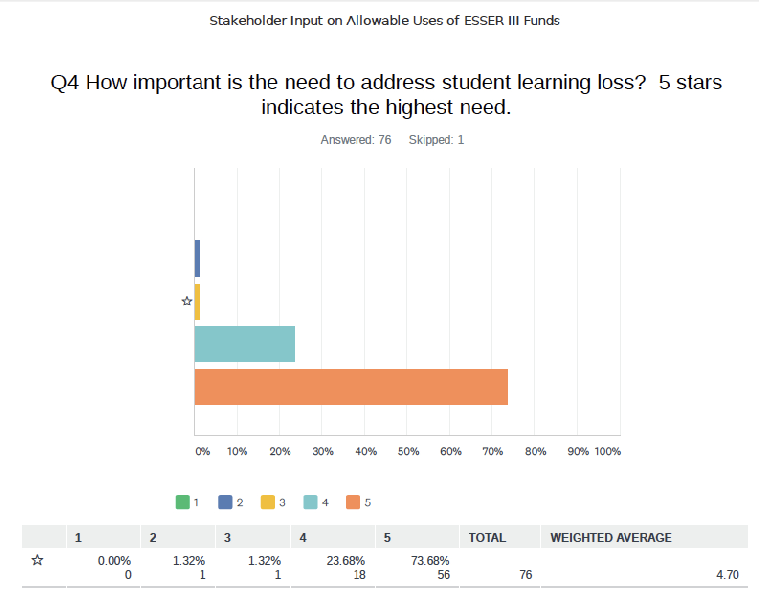
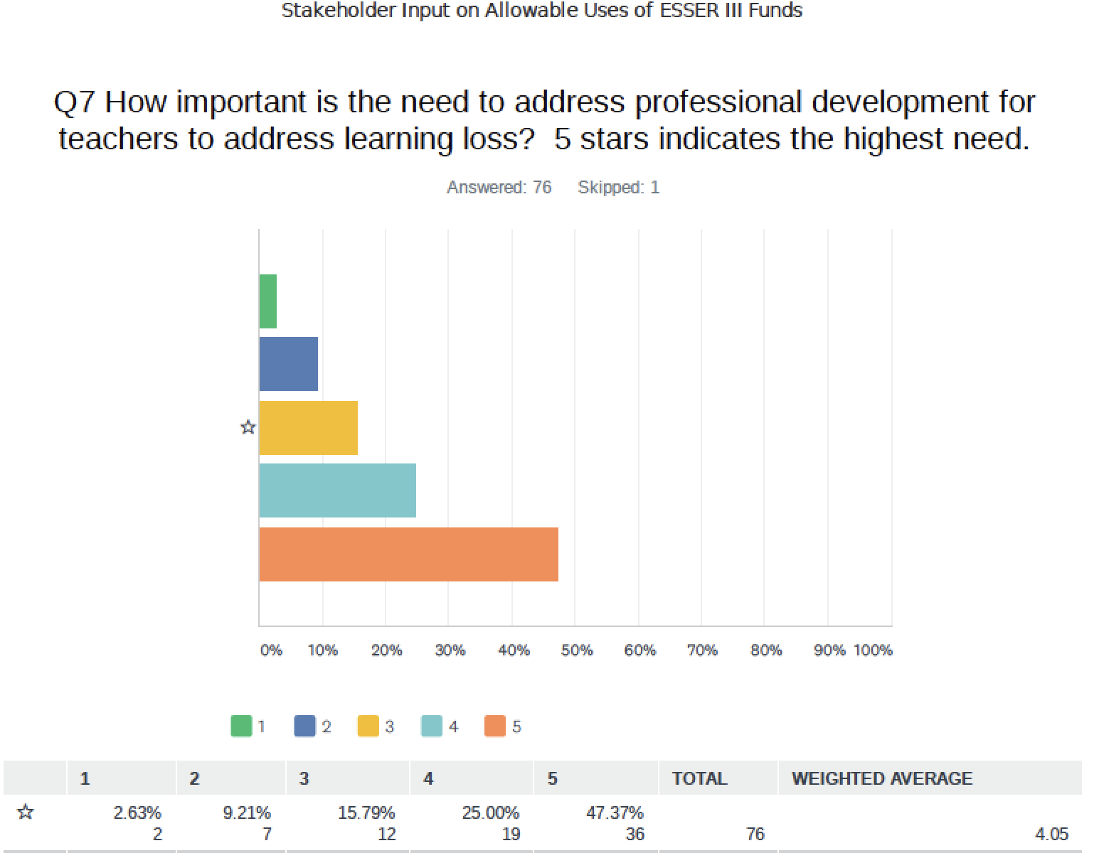
Results of the Community Survey

Slide 9
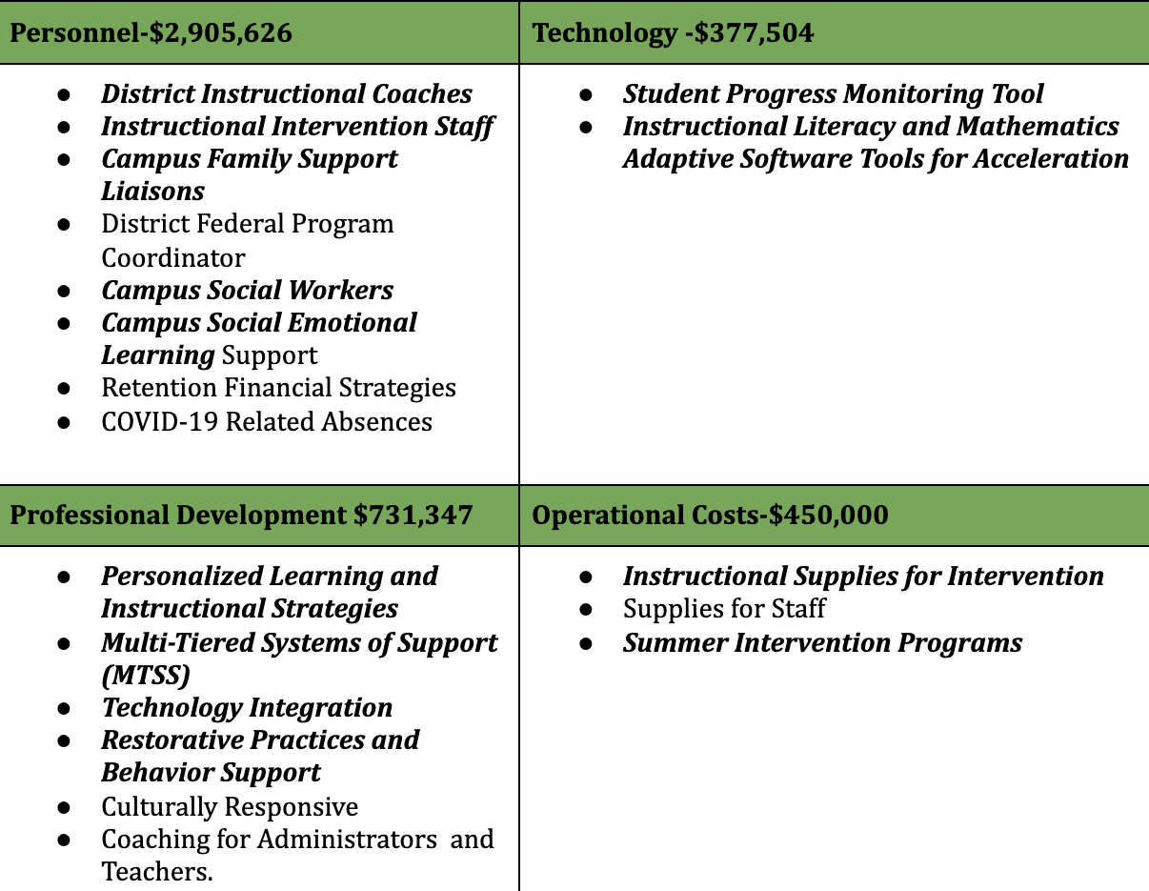
Taylor ISD’s Use of ESSER III Funds Plan

Slide 10
At this time, I would like to invite anyone to ask a question or give specific input on how Taylor ISD should utilize these additional resources.

Slide 11
For more questions or more information please contact:
Jennifer Patschke
Executive Director of Elementary Schools and Federal Programs
jhp@taylorisd.org
512-352-6361

